Slide 1
CS 447/647
Software Management

Slide 2
Overview
What is required for a network-based installation?
What is a high-level package manager? (Know Debian + RHEL)
What is a low-level package manager? (Know Debian + RHEL)
What is Debian?
How is a .deb package structured?

Slide 3
Installation
Many different Methods
Media - Easiest but doesn’t scale
  USB
  CDROM
  DVD
Network - Scales but requires development
  PXE, iPXE more likely
  TFTP
  DHCP
  PXE Kernel
  PXE Menu
chroot - Specialized
  Virtual Machines
  Containers

Slide 4
Installation - Media
wget \
https://mirrors.ocf.berkeley.edu/ubuntu-releases/24.04.2/ubuntu-24.04.2-desktop-amd64.iso
dd if=ubuntu-24.04.2-desktop-amd64.iso of=/dev/sd[a-z] bs=1M
# or use a GUI
UNetbootin, Rufus

Slide 5
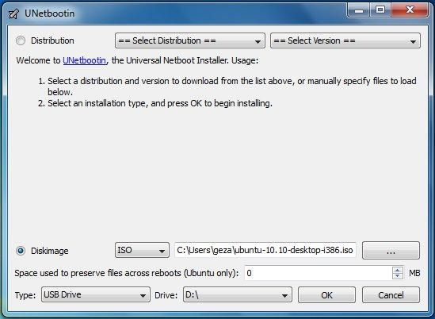
Installation - Media

Slide 6
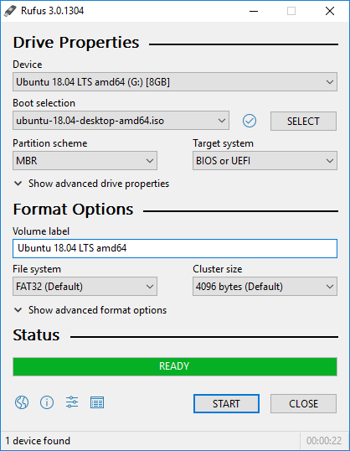
Installation - Media

Slide 7
Network

Slide 8
Network
Much more advanced than a media based installation
Requires
  DHCP
  iPXE - https://ipxe.org/
  TFTP - Trivial File Transfer Protocol
  Networking knowledge
  Scripting and menu creation
  HTTP (optional but likely)
Some open-source solutions
  Cobbler
  FOG Project (https://fogproject.org/)

Slide 9
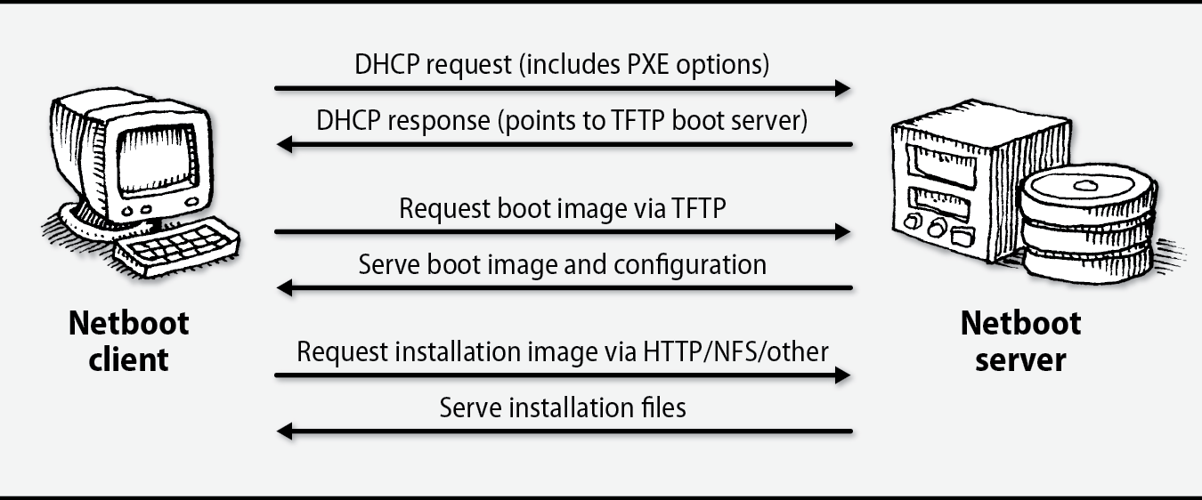
Network - PXE

Slide 10
Network - DHCP
Dynamic Host Control Protocol
RFC2131 - 1997
Provides a framework for passing configuration information to hosts on a TCP\IP network
UDP - User Datagram Packet Based
“DHCP in its current form is quite insecure.”
https://tools.ietf.org/html/rfc2131
Notes:
RFC2131 - DHCP passes configuration information including:
IP address, subnet, gateway, DNS server

Slide 11
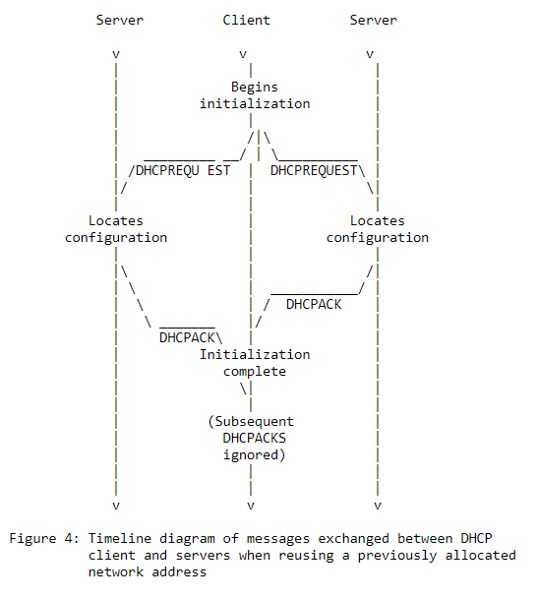

Slide 12
Network - DHCP Extensions
“Configuration parameters and other control information are carried in tagged data items that are stored in the 'options' field of the DHCP message.”
“Security issues are not discussed in this memo.”
RFC2132 - https://tools.ietf.org/html/rfc2132

Slide 13
Network - DHCP Extensions
3: Router
5: Name Server
6: DNS Server
9: LPR - Line Printer Remote protocol
12: Hostname
17: Root Path
51: IP Lease Time
66: TFTP server name
67: Bootfile name
61: Client-identifier - DHCP Client
190: Username 😲
191: Password 😲
RFC2939
https://ipxe.org/howto/dhcpd

Slide 14
Network - PXE
Two popular options
  PXELINUX in SYSLINUX
  iPXE (We use this)
    Scripting
    Proprietary Devices
    TLS Authentication
The PXE kernel is stored in the TFTP server’s tftpboot directory
The DHCP Server points to
  Server IP
  Filename
The kernel loads a menu
  PXELINUX - TFTP File
  iPXE - TFTP File, HTTP URL, Script

Slide 15
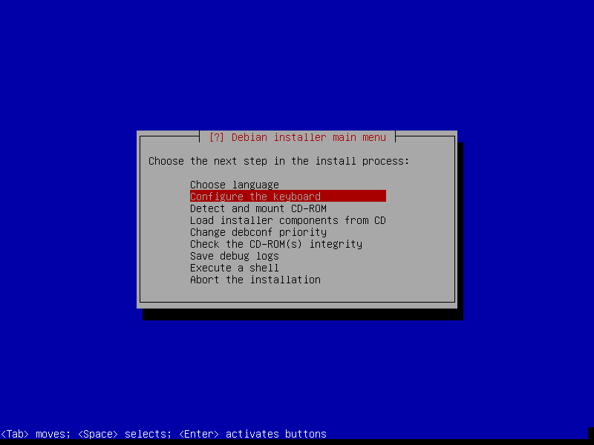

Slide 16
Network - PXE
# Debian preseed.cfg
# https://www.debian.org/releases/buster/example-preseed.txt
# Locale sets language and country.
d-i debian-installer/locale string en_US
# Keyboard selection.
d-i console-setup/ask_detect boolean false
d-i console-setup/layoutcode string us
### Network configuration
d-i netcfg/choose_interface select eth0
d-i netcfg/dhcp_timeout string 60

Slide 17
Package Management

Slide 18
Package Management
.tar.gz was the original package format
  Had to compile
  Messy
Package management systems
  Create order from chaos*
  Easy to install and remove packages
  Contains
    Binaries, shared libraries, manpages and configuration files
  Handle dependencies
  Run scripts before, during and after installation
    systemctl

Slide 19
Package Management
Package versions different than software versions
apt search strace | grep ^strace
strace/bionic,now 4.21-1ubuntu1 amd64 [installed]
strace -V
strace --version
UNKNOWN

Slide 20
Package Management
System administrators can create packages
  rpm for CentOS\Redhat
  dpkg for Debian\Ubuntu
  snap - self-contained, no dependencies
    flatpak for Fedora
Meta-packages or group installs (Redhat)
  Package that contains nothing
  Used to install other packages
  “ubuntu-desktop”

Slide 21
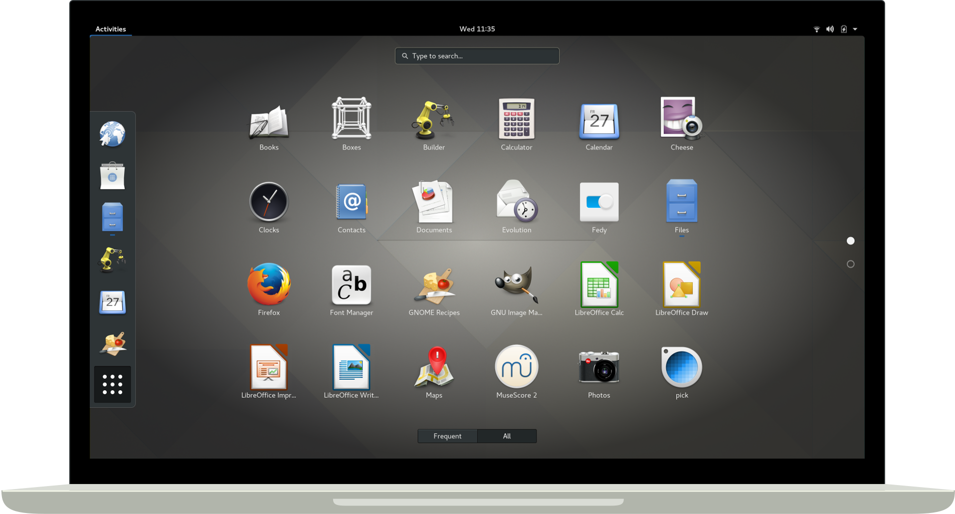

Slide 22
rpm - Redhat\CentOS
RPM Package Manager (rpm)
Useful arguments
  -i (install), -U (upgrade), -e (erase), and -q (query)
Query all packages
  rpm -qa
  rpm -qa | grep strace
List files in a package
  rpm -ql strace
Not often used alone
  Dependency hell
    rpm -q --whatrequires strace

Slide 23
dpkg - Debian
Package manager for Debian
Useful arguments
  -i (install), -r (remove)
Query all packages
  dpkg -l
List files in a package
  dpkg -L strace
Reconfigure - dpkg-reconfigure
  apt install slapd
  dpkg-reconfigure slapd

Slide 24
High-Level Package Managers

Slide 25
High-Level Package Managers
Meta Packaging system
  apt - Debian/Ubuntu
  dnf - Fedora/Redhat/CentOS (formerly used yum)
Simplifies
  Finding packages
  Automates installation,updating and OS upgrading
  Handle inter-package dependencies
Requires a significant amount of infrastructure
  Maintainers
  Web-servers
  Certificates
Distributed
  Anyone can host a repository

Slide 26
High-Level Package Managers
Red Hat Network
  Commercial
  Offers site-wide system management
  Works with the proprietary Satellite Server
  Supports apt and dnf
APT*
  Better documentation
  Vibrant community
  rpm support (alien)
  dpkg + .deb
dnf
  RHEL\CentOS
  RPMs
  “Enterprise”
*preferred

Slide 27
Package repositories
HTTP or FTP based
  https://mirrors.ocf.berkeley.edu/ubuntu
Supports a release
  18.04 bionic or 9.1 stretch
  Package versions are frozen
    4.15 Kernel
  Security updates - Backported
Component
  Subset of software
  main, free, non-free, contrib
    Debian Free Software Guidelines (DFSG)
      https://www.debian.org/social_contract.en.html
  GPL vs non-GPL
Architecture
  i686, amd64, and arm64

Slide 28
Package repositories
Individual packages
  Example: python3 (python3.6)
  Make up components
  Architecture-specific
  Versioned independently
“extras”
  Multiverse and universe
    Non-free components
  Manually added
  Examples
    Oracle Java, and NVIDIA

Slide 29
/etc/apt/sources.list
#Basic
deb http://httpredir.debian.org/debian buster main contrib non-free
#Backports
deb http://httpredir.debian.org/debian buster-backports main contrib non-free
apt search wireguard

Slide 30
Backports
Backports are packages taken from the next Debian release
Recompiled for usage on Debian stable
Easily upgraded
Recommended to only select single backported packages that fit your needs
https://backports.debian.org/

Slide 31
Advanced Packaging Tool (APT)
Mature
  First released in 1999 as part of Debian 2.1 (Slink)
Supports updates and upgrades
  Moving from one release to another.
  18.04 -> 20.04
  yum does not support release upgrades, but dnf does
Distros contain many metapackages (yum calls them groupinstalls)
  linux-image-generic
  xfce-desktop
  build-essential
Includes low level utilities
  apt-file
  apt-cache

Slide 32
Commands
apt update # apt downloads lists
# from repos defined in /etc/apt/sources.list
apt search neovim # Look for NeoVIM
apt show neovim # Show neovim information
apt-cache madison neovim # Show Versions
apt-cache madison gcc # Show GCC versions
apt -s install gcc=4:7.3.0-3ubuntu2 # Downgrade
apt-cache depends neovim # Show neovim depencies
apt-cache stats
apt-cache policy gcc # Displays preferences

Slide 33
Debian Packaging
https://www.debian.org/doc/manuals/packaging-tutorial/packaging-tutorial.en.pdf

Slide 34
What is Debian?
GNU/Linux distribution
  coreutils: https://www.maizure.org/projects/decoded-gnu-coreutils/
  gcc
1st major distro developed “openly in the spirit of GNU”
Non-commercial, built collaboratively by over 1,000 volunteers
3 main features:
  Quality – culture of technical excellence
  We release when it’s ready
  Freedom – devs and users bound by the Social Contract
  Promoting the culture of Free Software since 1993
  Independence – no (single) company babysitting Debian
  And open decision-making process (do-ocracy + democracy )
Amateur in the best sense: done for the love of it

Slide 35
Debian Packages
.deb files (binary packages)
  A very powerful and convenient way to distribute software to users
  One of the two most common package formats (with RPM)
Universal:
  30,000 binary packages in Debian
    most of the available free software is packaged in Debian!
  For 12 ports (architectures), including 2 non-Linux (Hurd; KFreeBSD)
  Also used by 120 Debian derivative distributions

Slide 36

.deb Packaging Format
.deb file: an ar archive
$ ar tv wget_ 1 .12 -2.1 _i386 . deb
debian-binary: version of the deb file format, "2.0\n"
control.tar.gz: metadata about the package
control, md5sums, (pre|post)(rm|inst), triggers, shlibs, . . .
data.tar.gz: data files of the package

Slide 37
.deb Packaging Format
You could create your .deb files manually
http://tldp.org/HOWTO/html_single/Debian-Binary-Package-Building-HOWTO/
But most people don’t do it that way

Slide 38
Tools
A Debian (or Ubuntu) system (with root access)
Some packages:
  build-essential: has dependencies on the packages that will be assumed to be available on the developer’s machine (no need to specify them in the Build-Depends: control field of your package)
    includes a dependency on dpkg-dev, which contains basic Debian-specific tools to create packages
  devscripts: contains many useful scripts for Debian maintainers
Many other tools are available, such as debhelper, cdbs, quilt, pbuilder, sbuild, lintian, svn-buildpackage, git-buildpackage, . . .
Install them when you need them.

Slide 39
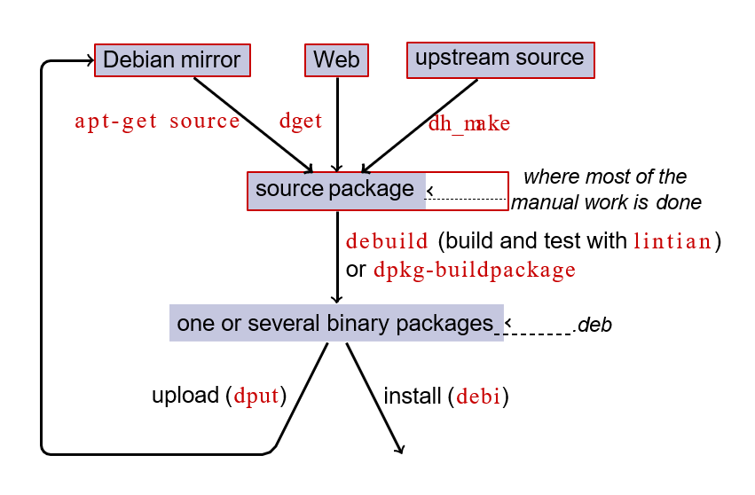
Workflow

Slide 40
Rebuilding dash
Install packages needed to build dash, and devscripts
sudo apt-get build-dep dash
(requires deb-src lines in /etc/apt/sources.list)
sudo apt-get install --no-install-recommends devscripts fakeroot
Create a working directory, and get in it:
mkdir /tmp/debian-tutorial ; cd /tmp/debian-tutorial
Grab the dash source package
apt-get source dash
(This needs you to have deb-src lines in your /etc/apt/sources.list)
Build the package
cd dash-*
debuild -us -uc (-us -uc disables signing the package with GPG)
Check that it worked
There are some new .deb files in the parent directory
Look at the debian/ directory
That’s where the packaging work is done
Notes:
-us
Do not sign the source package.
-uc
Do not sign the .changes file.

Slide 41
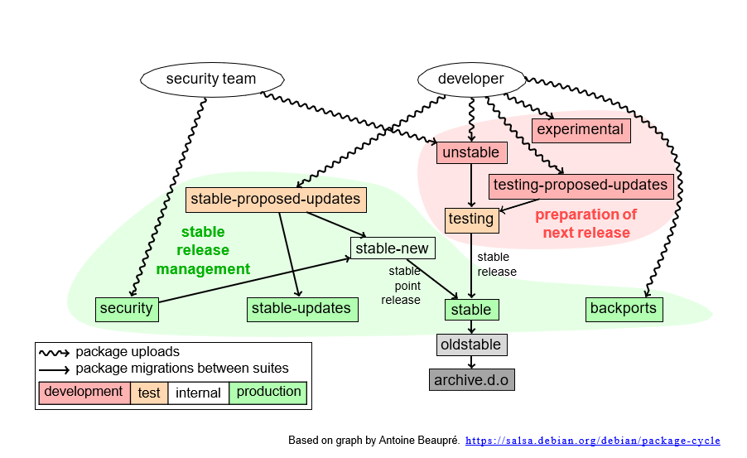
Workflow

Slide 42
Testing
The package has been in "unstable" at least for 2-10 days (depending on the urgency of the upload).
The package has been built for all the architectures which the present version in testing was built for.
Installing the package into testing will not make the distribution more uninstallable.
The package does not introduce new release critical bugs

