Slide 1
CS 447/647
Logging

Slide 2
Overview
General
Log Locations
systemd Journal
syslog
Kernel and Boot-time logging
Logging at scale

Slide 3
What is logging?
Line of text with properties
  Timestamp
  Type
  Severity
  Process Name
  PID
Used to glean useful, actionable information
  AKA Log Management

Slide 4
tail -n 2 /var/log/syslog
Feb 16 09:36:53 banyan dnsmasq[21819]: using nameserver 134.197.5.1#53
Feb 16 09:36:53 banyan systemd[1]: Started dnsmasq - A lightweight DHCP and caching DNS server.

Slide 5
Log Management
Collecting logs from a variety of sources
Providing a structured interface for analysis
  Filtering
  Monitoring
Managing the retention
  Legal - eDiscovery
    UNR has a 90 day policy
syslog - The traditional system for Unix logging
  Handles storing and forwarding logs
  Does not provide filtering or monitoring
  Bypassed by certain applications

Slide 6
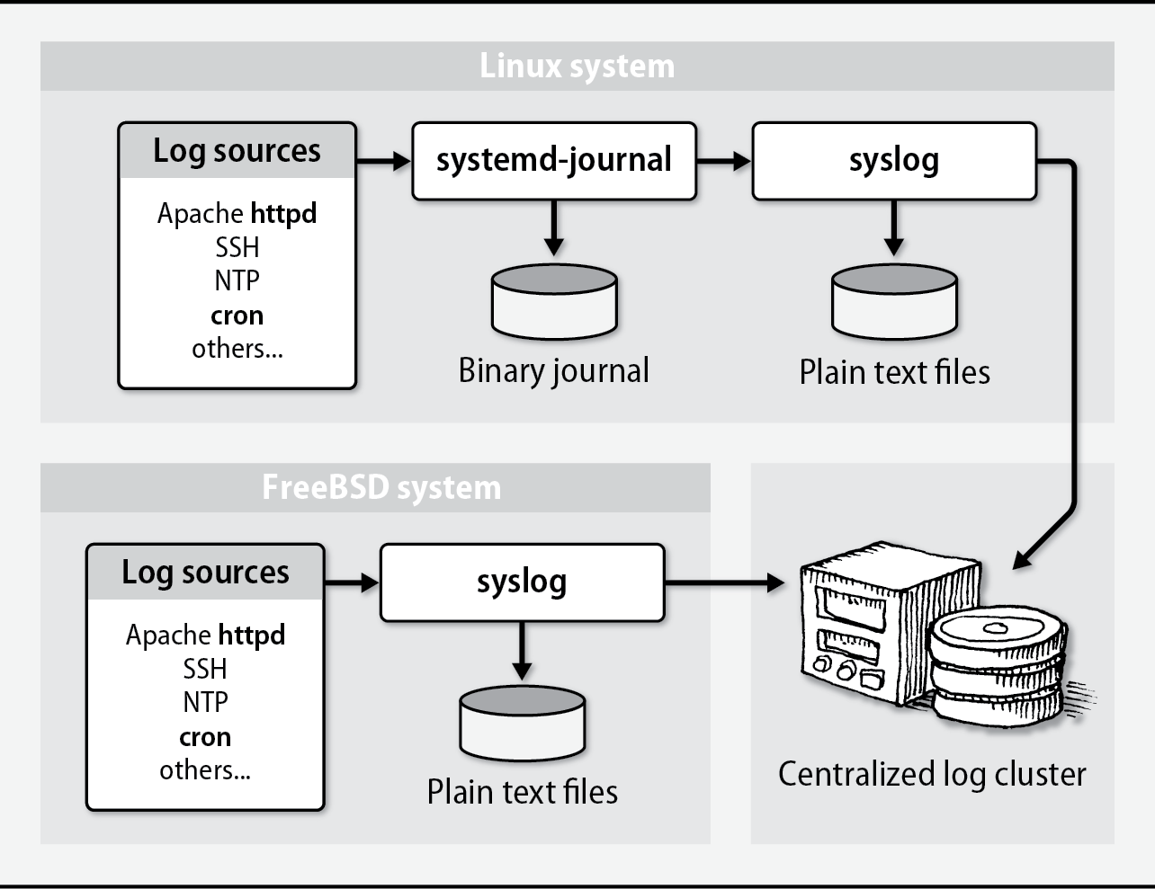

Slide 7
Why?
Regulatory Compliance
  PCI DSS - Payment, Visa, MasterCard...
  COBIT - IT Governance
  ISO 27001
Debugging
Configuration errors
Security

Slide 8
Log Locations
Most logs are in /var/log
Important ones:
  auth.log - Authentication & Authorizations
    sudo, ssh, PAM
  mail - All mail facilities
  messages - Main system log
  syslog - System log file
Mostly owned by root
  httpd - www-data
  uwsgi - user-defined
/var/log is often on a separate partition.

Slide 9
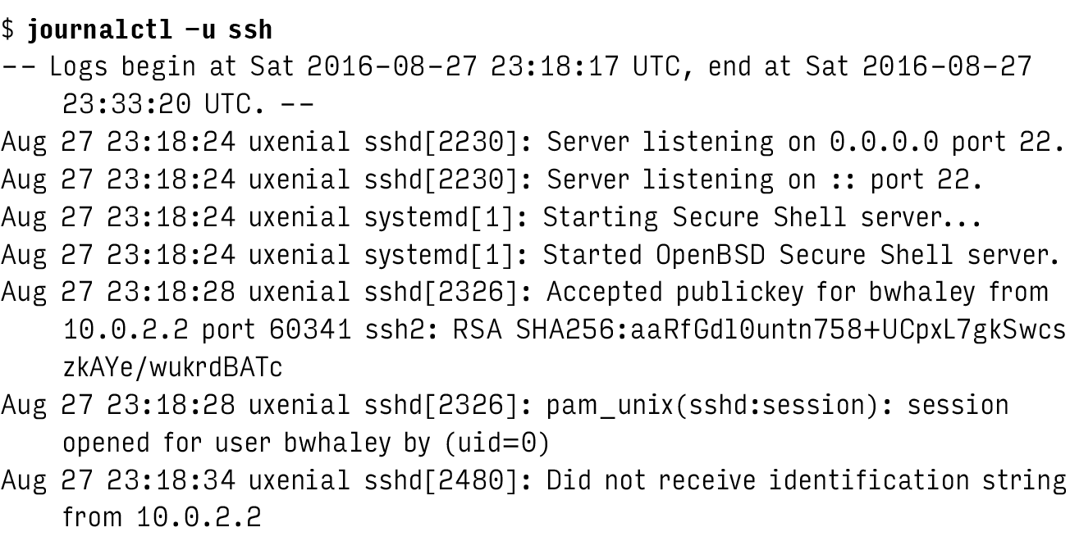
Viewing log files

Slide 10
systemd Journal
System service that collects and stores logging data
Stores log entries in a binary format
  Indexed
Collects entries from
  /dev/log - socket
  /dev/kmsg - kernel
  /run/systemd/journal/stdout - collects stdout from services
  /run/systemd/journal/socket - API

Slide 11
Configuring journald
/etc/systemd/journald.conf
/etc/systemd/journald.conf.d
[Journal]
#Storage=auto
#Compress=yes
#Seal=yes
#SplitMode=uid
#SyncIntervalSec=5m
….
Notes:
Storage - How long the logs will be stored in memory
Seal - used to protect journal files from unnoticed alteration
SplitMode - Controls whether to split up journal files per user, either "uid" or "none".
SyncIntervalSec - The timeout before synchronizing journal files to disk.

Slide 12
journalctl filters
journalctl -b 0 -u ssh
journalctl --since=yesterday --until=now
journalctl -n 100 /usr/sbin/sshd

Slide 13
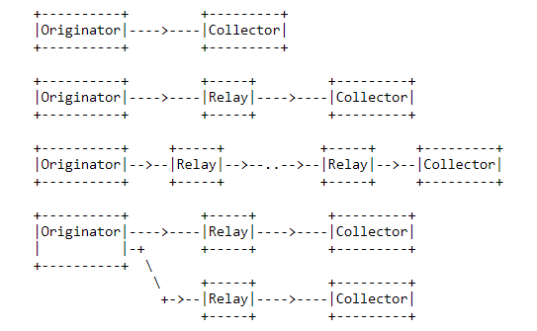
syslog
Logging system and IETF protocol
  RFC5424

Slide 14
syslog
Two functions
  Elevate developers from having to write logging systems
  Administrative control over logging
Logs can be sorted by
  Source - Facility
  Importance - Severity Level
Centralized logging
Modern version is rsyslog
  reliable and extended syslogd

Slide 15
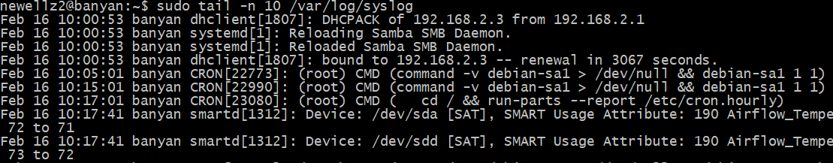
Reading syslog messages
tail -n 20 /var/log/syslog
Fields
  Timestamp
  Hostname
  Process name and PID
  Message

Slide 16
rsyslog
Configuration in /etc/rsyslogd.conf
Starts at boot
Uses /dev/log (Unix Domain Socket)
Supports
  Files
  MySQL
  Kafka

Slide 17
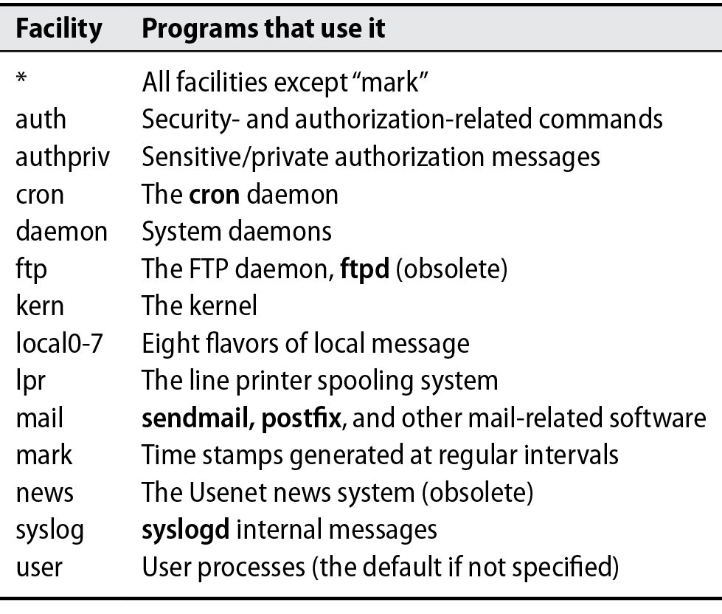

Slide 18
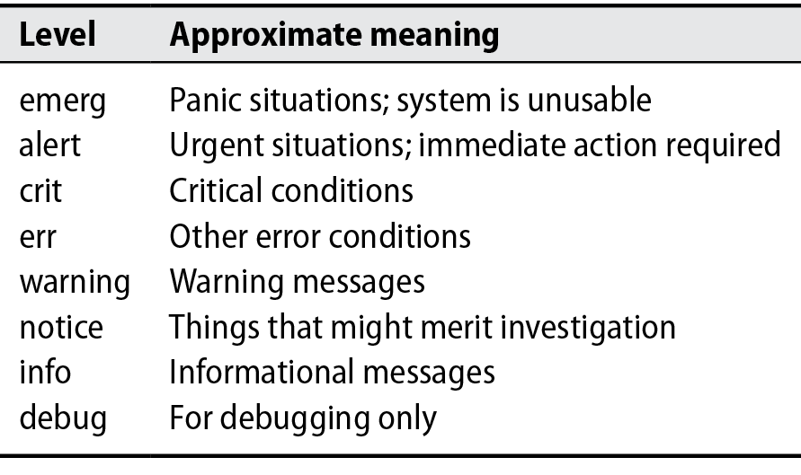

Slide 19
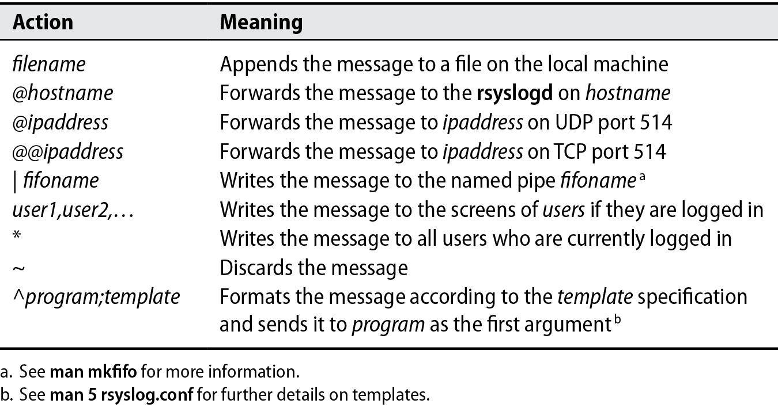

Slide 20
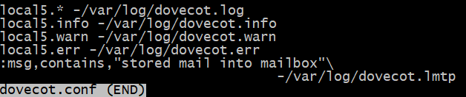

Slide 21
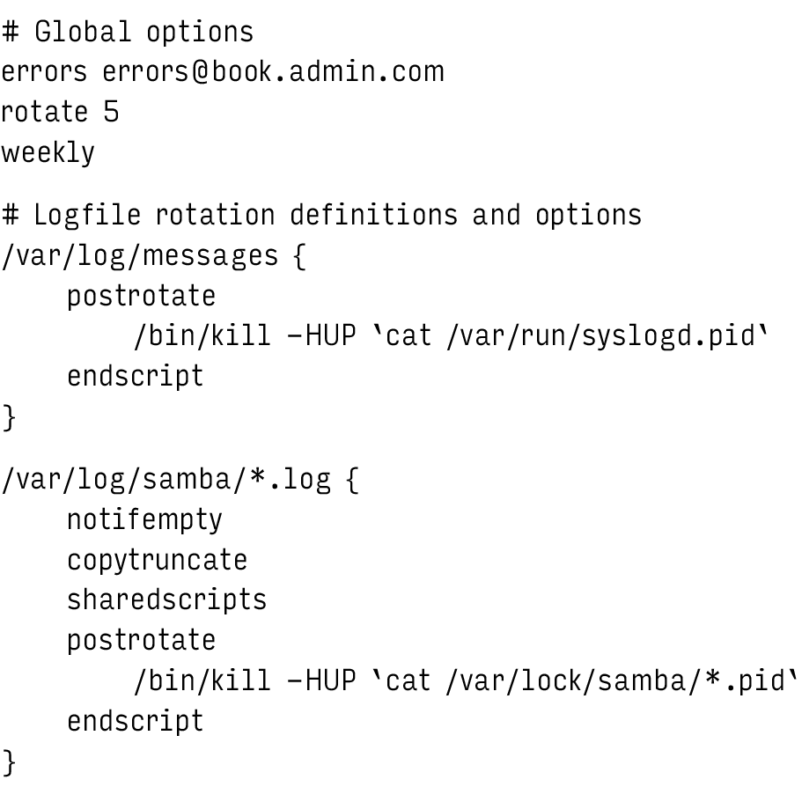
Log rotation

Slide 22
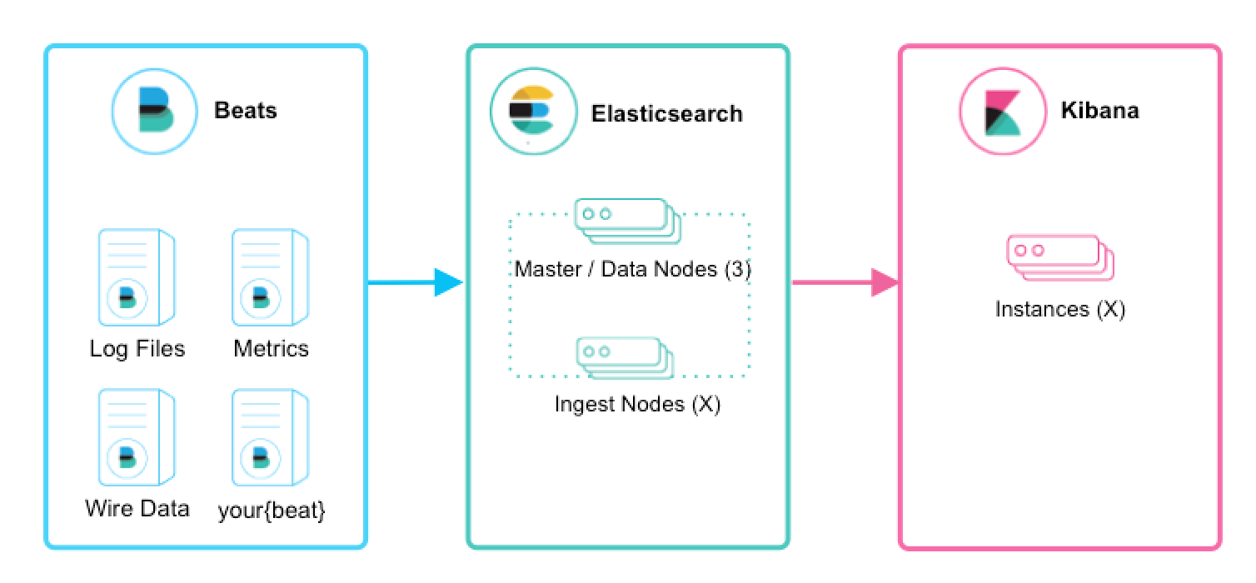
Logging at scale
Elasticsearch, Logstash, Kibana - ELK
  Open-source leader

